Slide 1
Bayesian Modeling in Oncology Trials
Part 1: Intro to Bayesian Methods in Oncology Trials
Stat4Onc Short Course
May 10, 2023

Slide 2


Instructors
Dr. Brian Hobbs
Associate Professor of Biostatistics, The University of Texas Dell Medical School
Email: brian.hobbs@austin.utexas.edu
Dr. Alex Kaizer
Assistant Professor of Biostatistics and Informatics, University of Colorado Anschutz Medical Campus
Email: alex.kaizer@cuanschutz.edu

Slide 3

Short Course Outline
Introduction to Bayesian Modeling in Oncology Trials
Information Sharing in Clinical Trials
Statistical Considerations for Master Protocols
Hybrid Controls in RCTs

Slide 4
Overall Learning Objectives
Exposure to the basics of Bayesian methods in oncology trials
Introduction of methods for sharing information across data sources
Understand use of master protocol studies (e.g., platform and basket trials) and statistical considerations
Bayesian methods for hybrid randomized controlled trials

Slide 5

Materials for Download
Alex’s GitHub:
https://github.com/alexbiostats/
Repo: Stat4Onc_2023

Slide 6
Why Bayes for Trials?
Ability to incorporate past trials beyond the “design” stage of a trial (e.g., through informative priors or information sharing approaches)
Increased flexibility (e.g., adaptive trial mechanisms and designs)
May be the “least burdensome” relative to frequentist approaches (FDA’s “Guidance for the Use of Bayesian Statistics in Medical Device Clinical Trials”)
Notes:
https://www.fda.gov/regulatory-information/search-fda-guidance-documents/guidance-use-bayesian-statistics-medical-device-clinical-trials [Guidance for the Use of Bayesian Statistics in Medical Device Clinical Trials]

Slide 7
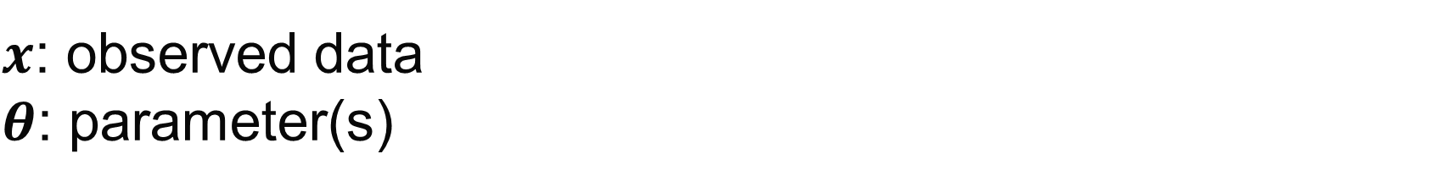
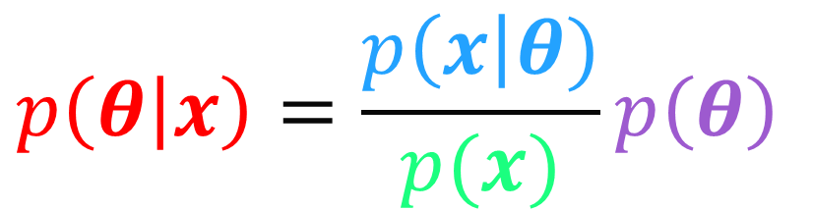

Bayes Overview
$x$: observed data
$θ$: parameter(s)
Likelihood
$$p\left(θ | x\right)=\frac{p\left(x\right|θ)}{p(x)}p\left(θ\right)$$
Posterior
Prior
Normalizing Constant
$$∫p\left(x | θ\right)p\left(θ\right)dθ$$

Slide 8
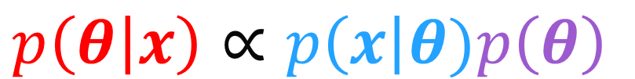
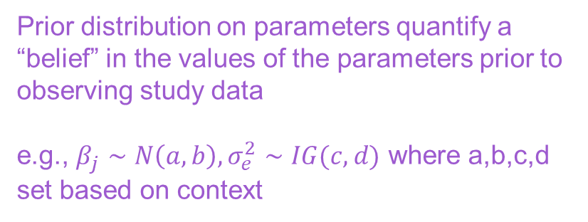
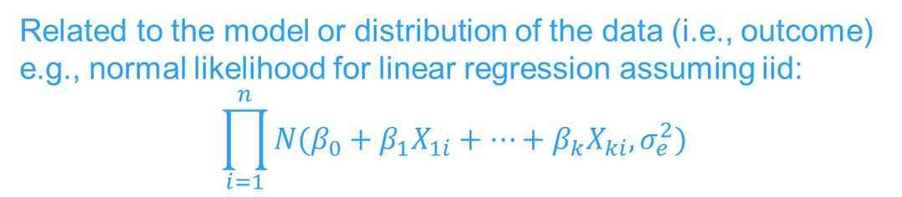
Bayes Overview
Related to the model or distribution of the data (i.e., outcome)
e.g., normal likelihood for linear regression assuming iid:
$$\prod_{i=1}^{n}{N(β_{0}+β_{1}X_{1i}+…+β_{k}X_{ki}, σ_{e}^{2})}$$
$x$: observed data
$θ$: parameter(s)
Likelihood
Posterior
$$p\left(θ | x\right)∝p\left(x\right|θ)p\left(θ\right)$$
Prior
Expresses uncertainty in the parameter(s) after observing the data and incorporating priors
Commonly summarized by its mean, median, or mode; probability; and credible interval from the Markov Chain Monte Carlo (MCMC) chain(s)
Prior distribution on parameters quantify a “belief” in the values of the parameters prior to observing study data
e.g., $β_{j}∼N\left(a,b\right), σ_{e}^{2}∼IG(c,d)$ where a,b,c,d set based on context

Slide 9
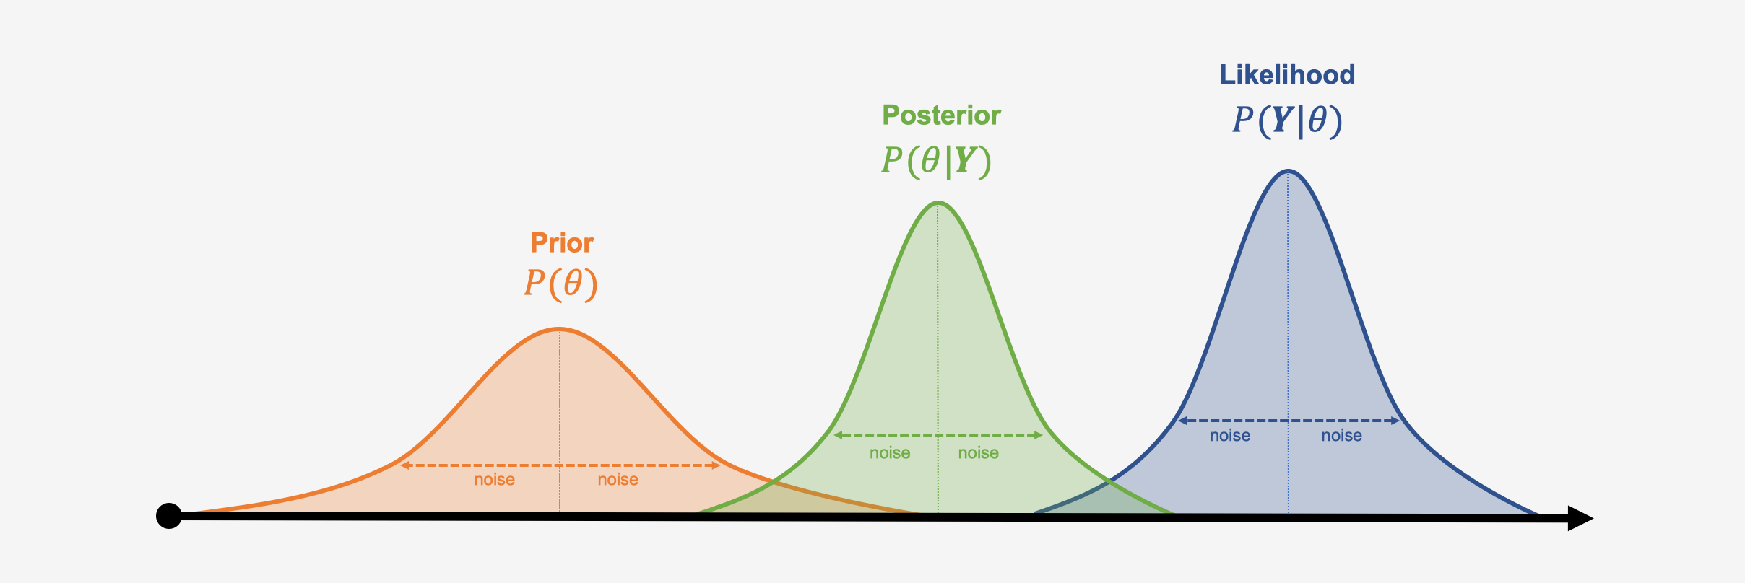
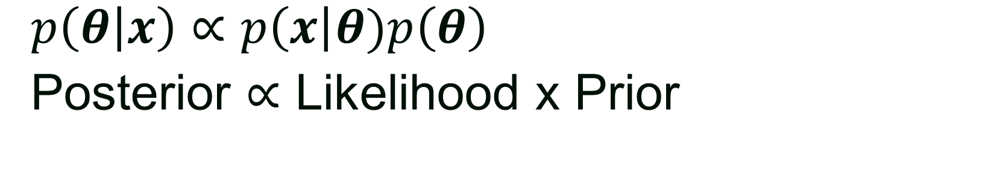
Bayes Overview
$p\left(θ | x\right)∝p\left(x\right|θ)p\left(θ\right)$
Posterior $∝$ Likelihood x Prior
Source:https://hudsonthames.org/wp-content/uploads/2020/10/bayesian.png

Slide 10
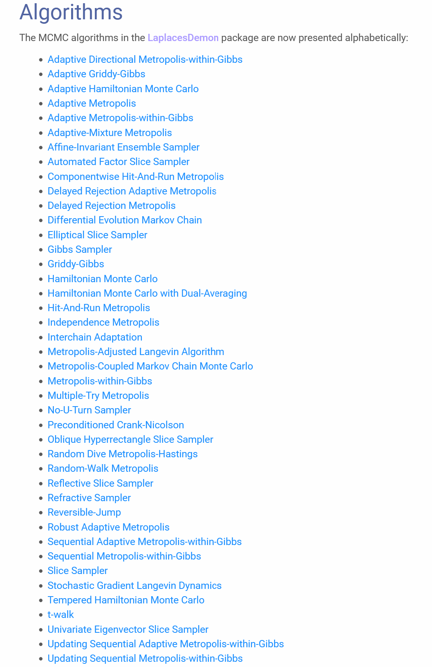
Markov Chain Monte Carlo (MCMC)
In Bayesian analyses, posterior is rarely known or closed form
Instead, we can use MCMC algorithms to simulate samples from the posterior distribution
Numerous algorithms have been proposed (e.g., 42 different ones in LaplacesDemon R package →)

Slide 11
MCMC cont.
Many software packages (e.g., PROC MCMC in SAS, brms in R) include default MCMC algorithms to avoid users having to code their own
Output from MCMC algorithms are usually rectangular datasets with a column for each chain and a row for each iteration
Chains are separate instances of the MCMC algorithm, often with different initial values
Burn-in periods are the first “X” of each chain discarded to provide time for convergence

Slide 12
MCMC Diagnostics
While not the focus of this short course, we note a few diagnostic tools and examples on the following slides for:
Trace plots
Autocorrelation plots
Density plots
Numerical diagnostics
Major goal is to assess whether simulation converged to the posterior distribution or if changes need to be made

Slide 13
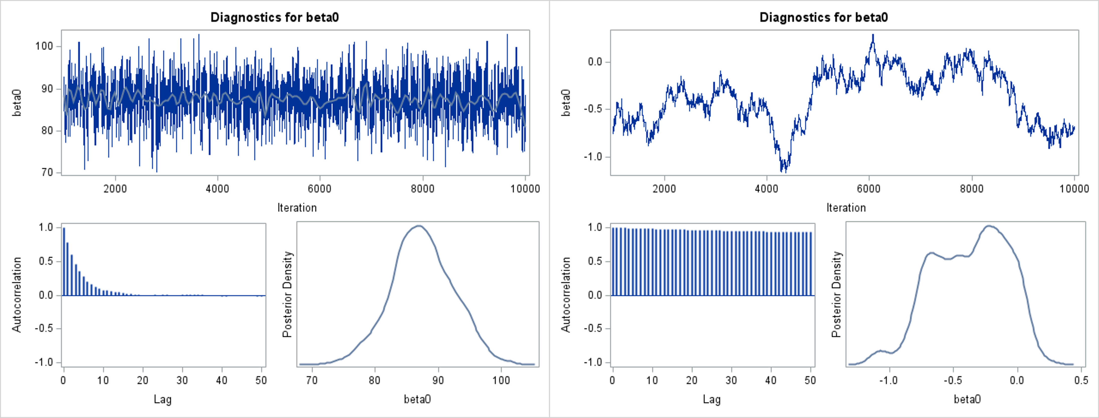
Trace Plots
Value of the parameter on the y-axis, iteration number on x-axis
Algorithmic convergence looks like random noise
Burn-in of 1000 iterations already removed from examples from PROC MCMC:
Good convergence ☺
Bad convergence ☹
Notes:
Bad convergence suggests poor mixing, so posterior may not have been fully explored. Could need to increase burn-in, alter other settings of chosen algorithm, etc.

Slide 14
Autocorrelation Plots
Pairwise correlation between iterations and different lags between iterations
Well-functioning algorithms should have a fairly steep decline as lag increases
This pattern suggests samples are likely to be random draws from the posterior and simulation has adequately sampled the support of the parameter

Slide 15
Density/Histogram Plots
Typically looking for a fairly smooth shape with a single mode
Bimodal or unusual patterns may indicate lack of convergence

Slide 16
Some Numerical Diagnostics
Varies by software, numerous exist
Geweke Diagnostic:
Compares values in early part of Markov chain to latter values
Provides a two-sided test with a large absolute z-score indicating rejection of convergence
R-hat:
A potential scale reduction factor proposed by Gelman and Rubin
Estimates convergence based on variance of estimated parameter between chains and variance within chain
Want values near 1

Slide 17
Priors
One of the more challenging aspects of Bayesian analysis
Depending on context/phase, may involve direct consultation with regulatory authorities (e.g., FDA)
Should evaluate a range of priors from skeptical/noninformative to more informative
May need to specify single prior for protocol/SAP
Can evaluate results and performance across other priors as secondary or sensitivity analyses

Slide 18
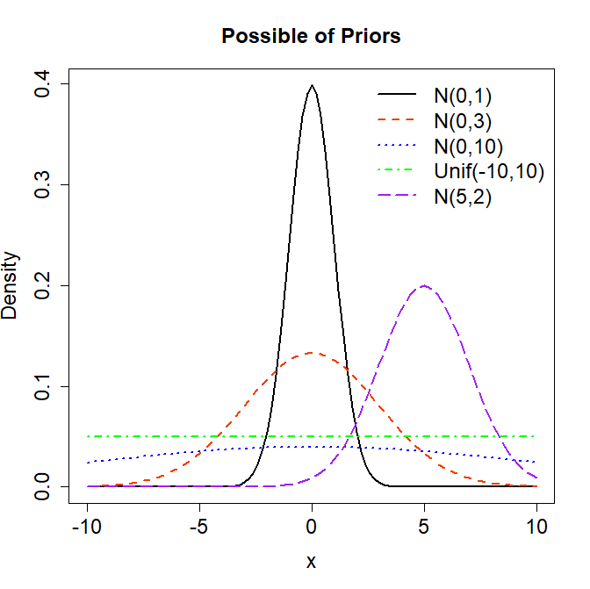
Examples of Priors
N(0,1): more informative, centered around 0
N(0,3): less informative with larger range of values
N(0,10): weakly informative
Unif(-10,10): flat prior (but suggests only values between -10 and 10 are possible)
N(5,2): informative for both mean and SD
Notes:
curve(dnorm(x, mean=0, sd=1), from=-10, to=10, xlab='x', ylab='Density', lwd=2, main='Possible of Priors', cex.axis=1.5, cex.main=1.5, cex.lab=1.5)
curve(dnorm(x, mean=0, sd=3), add=T, lwd=2, lty=2, col='orangered2')
curve(dnorm(x, mean=0, sd=10), add=T, lwd=2, lty=3, col='blue')
curve(dunif(x, -10, 10), add=T, lwd=2, lty=4, col='green')
curve(dnorm(x, mean=5, sd=2), add=T, lwd=2, lty=5, col='purple')
legend('topright', bty='n', lwd=c(2,2,2,2,2), lty=1:5, col=c('black','orangered2','blue','green','purple'), legend=c('N(0,1)','N(0,3)','N(0,10)','Unif(-10,10)','N(5,2)'), cex=1.5)

Slide 19

Software Availability
Bayesian methods used to require special software or separate coding languages
Now available in many forms:
R (brms, rstan/rstanarm, rjags)
JAGS/BUGS
STAN
SAS (PROC MCMC, PROC GENMOD)
Stata
Software has different defaults and options (e.g., number of chains, algorithms)

Slide 20

Logistic Regression Example
Let’s simulate an example to analyze using the brms package in R
Primary outcome: survival at 3 months
Assume:
Group 1=SOC, Group 2=New Treatment
p₁=0.1, p₂=0.4 (i.e., corresponds to OR=6)
N=32 per group

Slide 21
Data Simulation
library(brms) # load libraries
library(dplyr)
set.seed(20) # set for reproducibility
dat <- data.frame(
trt=c(rep(1,32), rep(0,32)),
out=c(rbinom(n=32,size=1,prob=0.4), rbinom(n=32,size=1,prob=0.1)) )

Slide 22
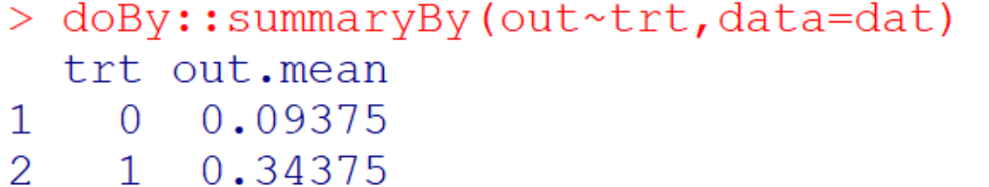
Simulated Data Check
# check simulated values
doBy::summaryBy(out~trt,data=dat)

Slide 23

Fit Logistic Regression Model
# brms Bayesian results with defaults
mod1 <- brm(out ~ trt,
data=dat,
family='bernoulli’,
prior = c(set_prior("normal(0,sqrt(10))", class = "b"),
set_prior("normal(0,sqrt(10))", class="Intercept")),
seed= 123,
warmup = 1000,
iter = 10000)
Syntax similar to glm
Set $N(0,\sqrt{10})$ priors
Set seed for reproducibility
Define burn-in iterations to discard
Set number of iterations per chain

Slide 24
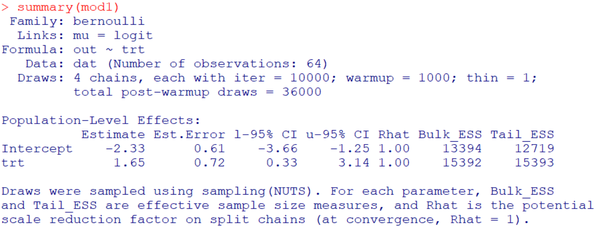
brms Logistic Regression Output
95% credible intervals
(2.5th and 97.5th quantiles)
mean from 36,000 iterations
R-hat convergence stat (1=converged)

Slide 25
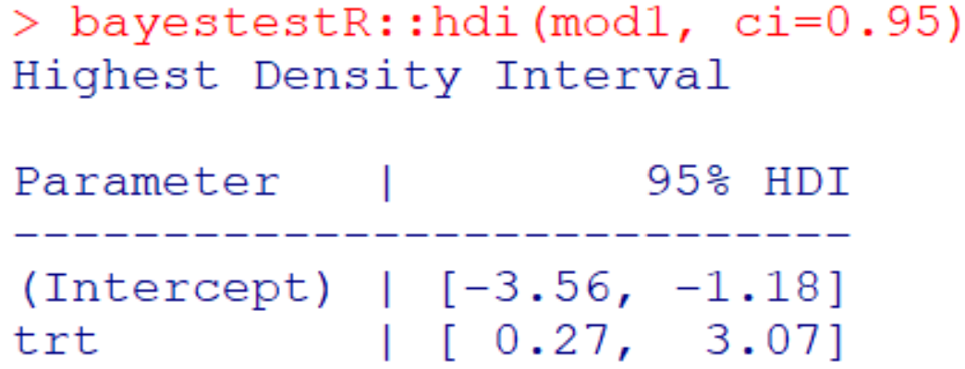
HPD Intervals
brms reports the 95% equal-tailed credible interval
This essentially calculates the 2.5th and 97.5th quantiles from the pooled posterior chains
i.e., the 0.025*36000=900th and 0.975*36000=35100th observation
The highest posterior density (HPD) interval is the narrowest interval that includes 95% of the posterior
Equal-tails may not be maintained
Similar to output of [0.33, 3.14] →

Slide 26
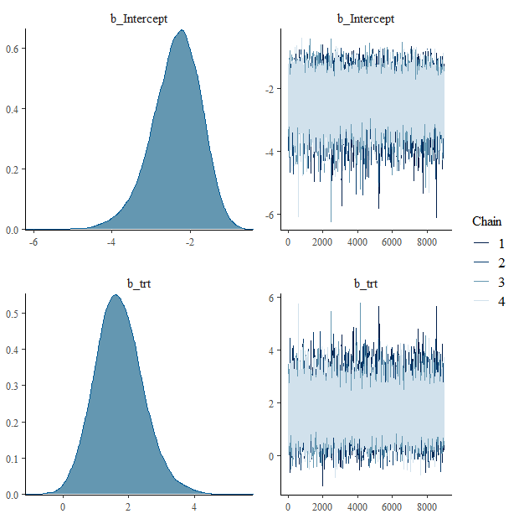
brms Logistic Regression Plots
plot(mod1)
Both beta coefficients show “smooth” density plots and trace plots that look like random noise
This suggests good convergence and mixing (confirming the R-hat values of 1.00)

Slide 27
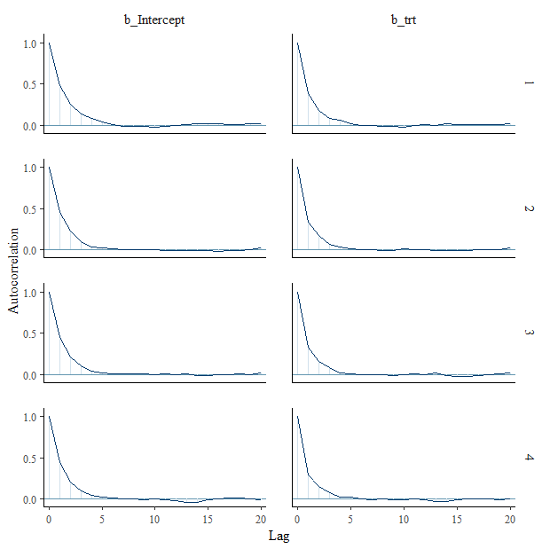
brms Logistic Regression Plots
mcmc_plot(mod1,type="acf")
Each chain has a plot for each beta coefficient
Rapid, steep declines seen; suggesting good exploration of the parameters’ support

Slide 28
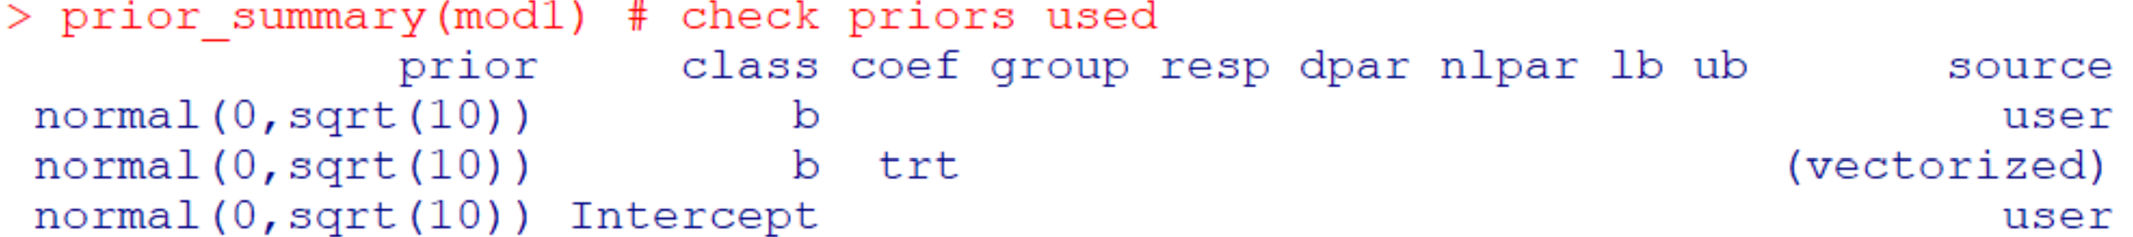
Check Priors Used
Can check what priors were used or defined for a given model
prior_summary(mod1) # check priors used

Slide 29
Odds Ratio and Posterior Probability
The posterior chains are currently on the log odds scale
Need to transform each iteration (i.e., exponentiate) to get the odds ratio to summarize:
post_samp <- post_samp %>%
mutate(exp_trt=exp(b_trt),
indicator=ifelse(exp_trt>1, 1, 0))
Estimates OR for each iteration
Indicator to estimate posterior probability that OR>1

Slide 30
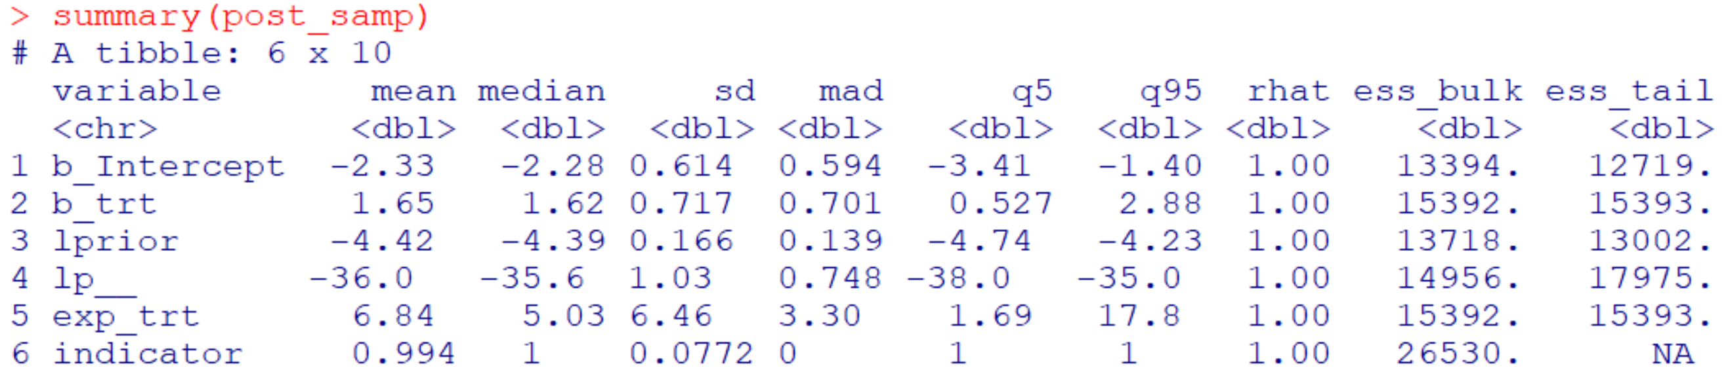
Odds Ratio and Posterior Probability
Posterior probability:
Pr(OR>1) = 0.994
Odds Ratio for Treatment:
Mean is 6.84 (≠ e^{1.648214} = 5.20; because mean of e^{x} isn’t same as e^{mean(x)})
Median is 5.03 (= e^{1.615389} = 5.21; because order doesn’t change)

Slide 31
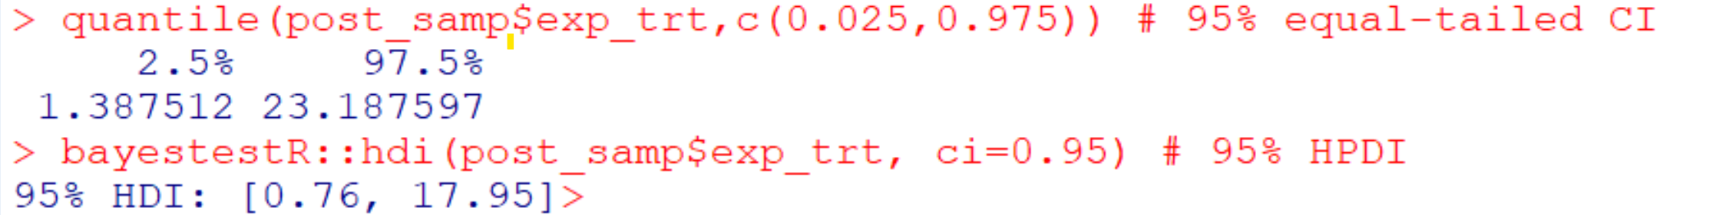
CrIs for OR
Can calculate 95% equal-tailed and HPD intervals:

Slide 32
Conclusion from Model
The odds of surviving to 3-months are 5.03 times higher (95% CrI: 1.39, 23.2; P(OR>1)=0.994) for those receiving treatment compared to standard of care.
Note: One should summarize in earlier methods that the median and equal tailed credible interval are being used in this example. Otherwise, this should be specified in the conclusion sentence.

Slide 33
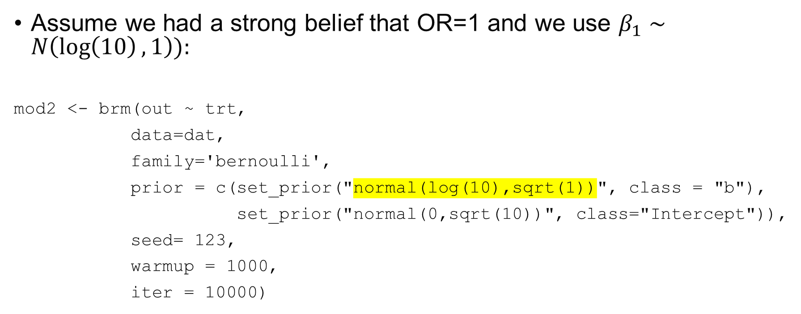
Model with Informative Treatment Prior
Assume we had a strong belief that OR=1 and we use $β_{1}∼N\left(\log\left(10\right),1\right)):$
mod2 <- brm(out ~ trt,
data=dat,
family='bernoulli',
prior = c(set_prior("normal(log(10),sqrt(1))", class = "b"),
set_prior("normal(0,sqrt(10))", class="Intercept")),
seed= 123,
warmup = 1000,
iter = 10000)

Slide 34
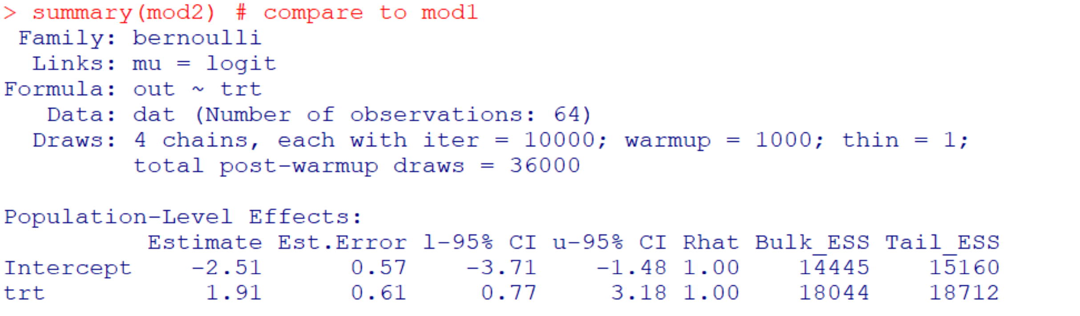
Informative Prior Results
Previous estimate: 1.65, so prior pulled up our estimate

Slide 35
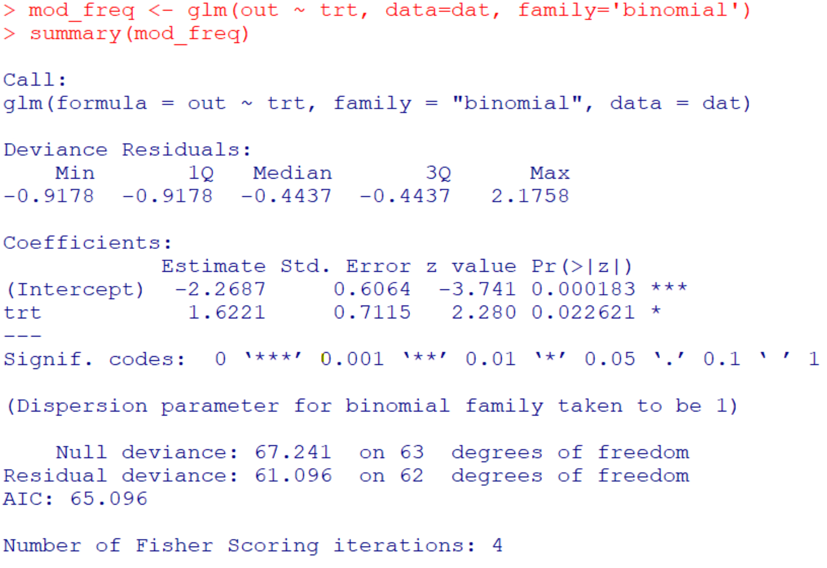
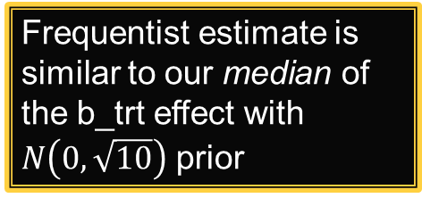
Frequentist Comparison
Frequentist estimate is similar to our median of the b_trt effect with $N\left(0,\sqrt{10}\right)$ prior

Slide 36
Checklist: Statistical Components to Include in Bayesian Data Analysis Plan
The outcome, primary variable of interest, and covariates with labels as to their function as adjustment for confounding, precision variables, or mediators, etc.
Regression modeling framework being used (linear regression, logistic regression, or other).
Prior distribution with parameters; a description of non-informative to informative and a justification for the selection when appropriate; multiple priors should be investigated over a range of assumptions regarding a priori beliefs about the values of the parameters.
Package and software version with specifics about the MCMC algorithm used.
Chain/iteration length and number, burn-in, and thinning if used.
Parameter initialization values.
Assessment(s) of convergence.
Description of how posteriors will be summarized.

Slide 37

Contact Info:
Emails:
alex.kaizer@cuanschutz.edu
brian.hobbs@austin.utexas.edu
Website: www.alexkaizer.com
GitHub: alexbiostats

Slide 38
Select References
Gunn-Sandell, L., et al. “A Practical Guide to Adopting Bayesian Regression Analyses in Clinical Research”, Submitted to Journal of Clinical and Translational Sciences.
US Food and Drug Administration. “Guidance for the Use of Bayesian Statistics in Medical Device Clinical Trials”, February 2010.
Paul-Christian Bürkner (2017). brms: An R Package for Bayesian Multilevel Models Using Stan. Journal of Statistical Software, 80(1), 1-28. doi:10.18637/jss.v080.i01
Paul-Christian Bürkner (2018). Advanced Bayesian Multilevel Modeling with the R Package brms. The R Journal, 10(1), 395-411. doi:10.32614/RJ-2018-017

